Slide 1

Vulnerability Assessment for Applications Security Through Penetration Simulation and Testing
AKASH MK
AWH22MCA-2005
Guide: Prajina k

Slide 2
Contents
Introduction
Penetration Testing and Vulnerability Assessments
Penetration Testing Phases.
Previous Work on Penetration Testing
Penetration Test Environment
Penetration Test Execution and Results
Exploiting Vulnerabilities
Post-Exploitation Analysis
Types of penetration testing
Conclusion

Slide 3

Introduction
Securing digital systems is crucial.
One effective method to enhance security is through penetration testing.
Helps uncover weaknesses and develop strategies to strengthen defense mechanisms.

Slide 4
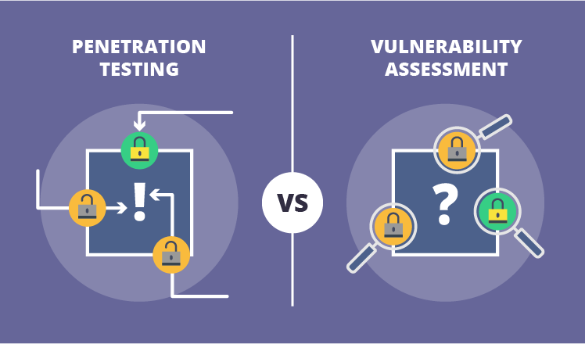
Penetration Testing and Vulnerability Assessments
Penetration testing is trending for system security analysis.
Also referred to as red teaming.
Red teams attack, blue teams defend.
Define goals and agree on threats before testing.
Helps narrow testing scope.

Slide 5


Penetration Testing Phases
Each phase contributes to:
Identifying vulnerabilities.
Assessing risks.
Providing recommendations for strengthening security defenses.

Slide 6
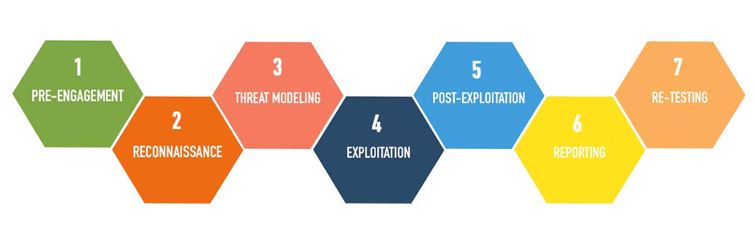
Has 7 phases :-
Pre-Engagement Scoping
Reconnaissance
Threat Modeling
Exploitation
Post-Exploitation
Reporting
Resolution/Re-Testing

Slide 7
(1) Pre-Engagement Scoping
Deciding exactly how and what will be tested.
Client and testing company outline what will be tested and how.
Sets the direction for the entire penetration test.

Slide 8
(2) Reconnaissance
Information is collected quietly about the organization's systems and networks.
Various methods to gather information :
OSINT Framework and Nmap
Social engineering and website inspection

Slide 9
(3) Threat Modeling/Vulnerability Identification
Use information gathered to create threat models.
Identify vulnerabilities based on threat models.
Conduct vulnerability assessments using tools like Nessus or OpenVAS.
Flexible with backup plans in case of issues.

Slide 10
(4) Exploitation
Information and analysis from previous stages are put into action.
Explore and exploit all vulnerabilities.
Important to document different stages of the exploit for future reference.
Depth and scalability of attacks are assessed.

Slide 11
(5) Post-Exploitation
Record methods and compromised resources.
Note potential harm.
Return system to original setup by removing new tools and accounts.

Slide 12
(6) Reporting
Report details steps, tools used, and mitigation strategies.
Can include security risks, threats, and recommended fixes.
Find and fix security risks to secure the organization.

Slide 13
(7) Resolution and Re-Testing
A penetration test ends with a final report.
But sometimes, re-testing is done.
This ensures that any vulnerabilities found have been properly addressed.

Slide 14
Previous Work on Penetration Testing
One study provides a detailed introduction to penetration testing.
Other studies focus on using penetration testing in software development.
Another study proposes an attack net penetration testing approach.
Penetration testing has been applied in domains like AMI.

Slide 15
Penetration Test Environment
Setting up a semi-automated system for conducting penetration tests.
Raspberry Pi running Kali Linux is used as the penetration testing box.
An SSH tunnel is established to a Virtual Private Server.

Slide 16
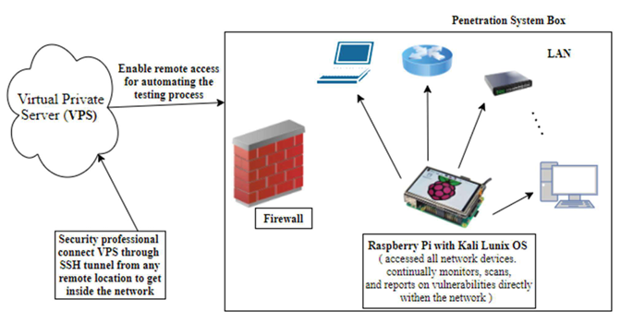
Figure 1 Penetration Test Environment

Slide 17
Penetration Test Execution and Results
Scoping: Defined testing scope with the client to prevent service disruption.
Reconnaissance: Gathered passive network information using various tools.
Threat/Vulnerability Identification: Used scanners to find open ports and operating systems.
Exploitation: Exploited vulnerabilities for remote code execution.
Reporting: Generated reports detailing vulnerabilities and network data.
Resolution/Re-Testing: Applied fixes and conducted re-testing for effectiveness.
Objectives: Obtained comprehensive network details.

Slide 18
Exploiting Vulnerabilities
Asset Analysis
Documentation
Vulnerability Exploitation

Slide 19
Post-Exploitation Analysis
Involves documenting all methods used.
Restore the system to its baseline configuration.
Ensures accurate reporting.

Slide 20
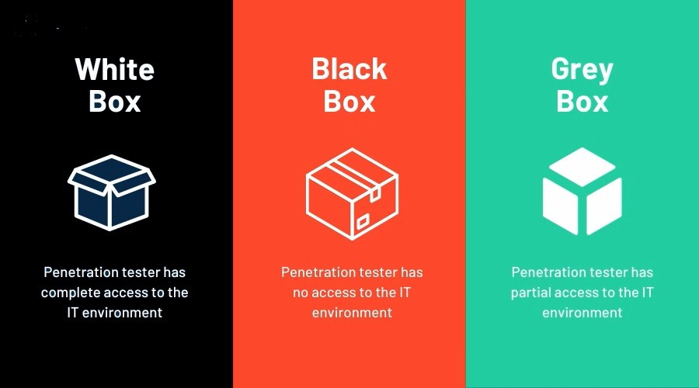
Types of penetration test

Slide 21
Conclusion
Explained the entire process of penetration.
Emphasized its ethical and legal importance.
Promotes a full security strategy, using offensive testing and defensive tactics for better protection.

Slide 22

Thank you

